Slide 1
THEORY OF COMPUTATION
Dr.S.Prince Mary M.E.,Ph.D., Associate Professor,
Department of Computer Science and Engineering,
School of Computing
SATHYABAMA
Institute of Science and Technology
Deemed to be University
Chennai.

Slide 2
UNIT- IV TURING MACHINE

Slide 3
Syllabus
Turing machines - Models of computation and the Turing thesis - Definition of TM and TM as language acceptor - Non-deterministic TM and Deterministic TM – Universal TM

Slide 4
Church Turing’s Thesis
For any mathematical problem solving – If that can be described by an algorithm then it can be modelled by a Turing machine.
Turing machine was invented in 1936 by Alan Turing.
It is an accepting device which accepts Recursive Enumerable Language and the languages accepted by other automata’s

Slide 5
Features of TM
It has an external memory which remembers arbitrary long sequence of input.
It has unlimited memory capability.
The model has a facility by which the input at left or right on the tape can be read easily.

Slide 6
Turing Machine
A Turing Machine (TM) is a mathematical model which consists of an infinite length tape divided into cells on which input is given.
It consists of a head which reads the input tape.
A state register stores the state of the Turing machine.
After reading an input symbol, it is replaced with another symbol, its internal state is changed, and it moves from one cell to the right or left.
If the TM reaches the final state, the input string is accepted, otherwise rejected.

Slide 7
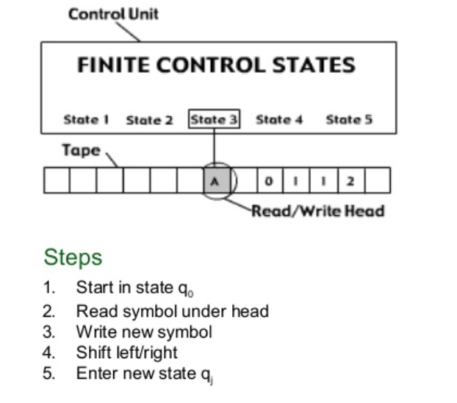
Turing Machine

Slide 8
Advantages of TM over PDA
A PDA can only access the top of its stack,
whereas a TM can access any position on an infinite tape.
The infinite tape cannot be simulated with a single stack, so a PDA is less computationally powerful.
There are algorithms that can be programmed with a TM that cannot be programmed with a PDA.
Machine | Data Structure | Deterministic?
Finite Automaton | N.A | Yes
Pushdown Automaton | Last In First Out(LIFO) | No
Turing Machine | Infinite tape (QUEUE) | Yes

Slide 9
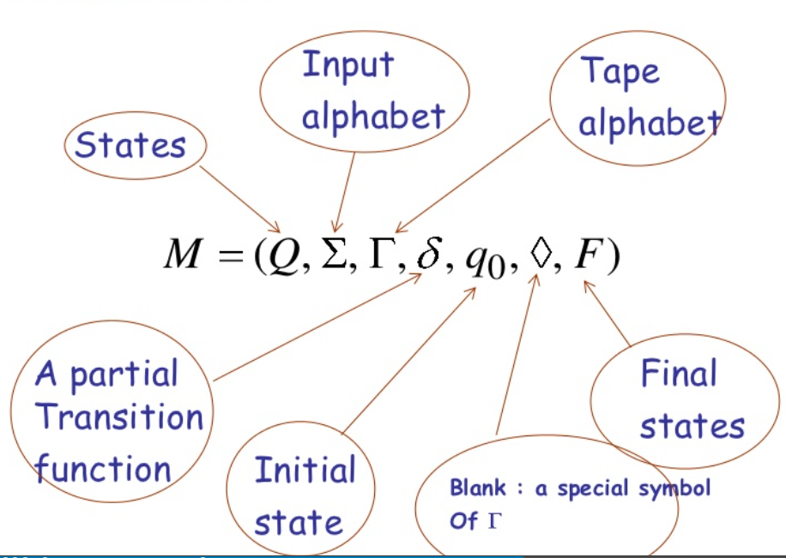
Formal Definition of TM
A TM can be formally described as a 7-tuple
(Q, Γ, ∑, δ, q₀, B, F)
where −
δ : Q × ∑ → Q × X × { Direction}.
Direction:
Left (L)
Right (R)
Same( S)

Slide 10
1. Construct TM for the language L ={a^{n}b^{n}} where n>=1.
Logic:
Read out each ‘a' mark it by X and then move ahead along with the input tape and find out b convert it to Y. Now, repeat this process for all a's and b’s.
How this Turing machine work for aabb:
1. B a a b b B | 6. B X a Y b B | 11. B X X Y Y B
2. B a a b b B | 7. B X a Y b B | 12. B X X Y Y B
3. B X a b b B | 8. B X X Y b B | 13.B X X Y Y B
4. B X a b b B | 9. B X XY b B | 14.B X X Y Y B
5. B X a Y b B | 10. B X X Y Y B | 15.B X X Y Y B

Slide 11
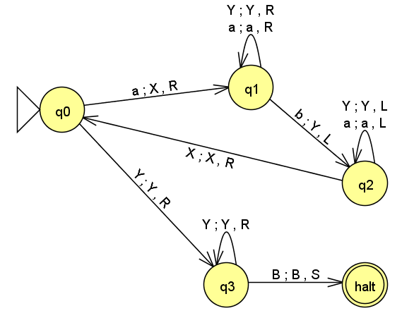
State Diagram

Slide 12
Transition Table
STATE | INPUT-a | INPUT-b | B | X | Y
q0 | (q1,X,R) | - | - | - | (q3,Y,R)
q1 | (q1,a,R) | (q2,Y,L) | - | - | (q1,Y,R)
q2 | (q2,a,L) | - | - | (q0,X,R) | (q2,Y,L)
q3 | - | - | (q4,B,B) | - | (q3,Y,R)
q4 Accept| Halt

Slide 13
ID
ID's for TM's are strings of the form:
α –q– β ,
where α, β ∈ Γ* and q ∈ Q
Example: Trace the string aabb:
q0 a a b b B
|-Xq1a b b B
|- X a q1b b B
|-X q2a Y b B
|-X a Y b B
|- q2X a Y b B
|-X q0a Y b B
|-X X q1Y b B
|-X X Y q1b B
|-X X q2 Y Y B
|-X q2X Y Y B
|-X X q0Y Y B
|-XXYq3YB
|- XXYYq3B
|-Halt (Accept | halt)

Slide 14
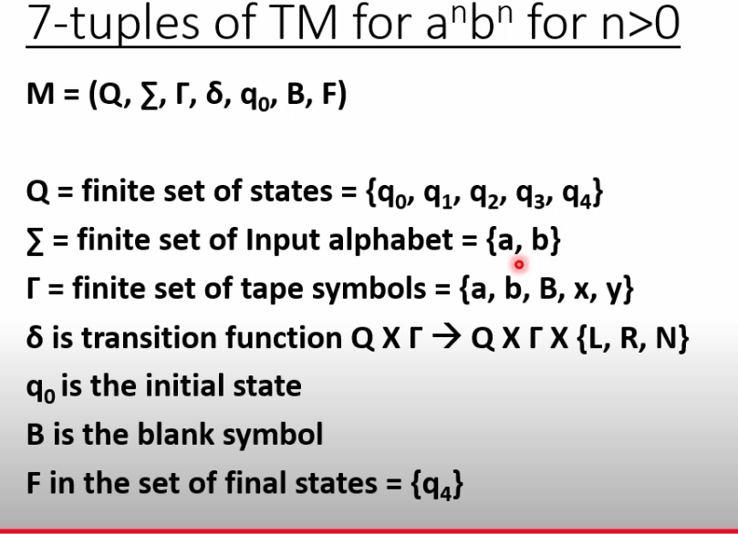

Slide 15
The Language Acceptance by TM
Let M=(Q, X, ∑, δ, q₀, B, F) be the language L(M) accepted by machine is defined by
L(M)= { wq0w |------ α1 α2p }
Where w ∈ ∑*, p ∈ F, α1 α2 ∈ Γ*
When TM will Crash:
If D=L but the tape head already scanning square (Left most square). Then the tape head is not allowed to move.
When the state r=h then this move causes the TM to halt
ID- Instantaneous Description:
Initial ID : q0 α1 α2
Final ID : α1 α2 qB
q0-> start state
q ∈ F -> Final state
TM can do one of the following things:
Halt & Accept by entering the final state
Halt & Reject
Tm will never Halt and enters into infinite loop

Slide 16
2.Design TM to accept strings of Palindrome
Even Palindrome-abba
1. B a b b a B | 6. B B b b a B | 10. B B b b B B | 15.B B B B B B
2. B a b b a B | 7. B B b b a B | 11. B B b b B | 16.B B B B B B
3. B B b b a B | 8. B B b b B B | 12. B B B b B B | 17.B B B B B B
4. B B b b a B | 9. B B b b B B | 13. B B B b B B
5. B B b b a B |  | 14. B B B b B B | Halt

Slide 17
2.Design TM to accept strings of Palindrome
Odd Palindrome-aba
1. B a b a B | 6. B B b a B | 10. B B B B B
2. B a b a B | 7. B B b B B | 11. B B B B B
3. B B b a B | 8. B B b B B | 12. B B B B B
4. B B b a B | 9. B B b B B | Halt and accept
5. B B b a B

Slide 18
2.Design TM to accept strings of Palindrome
Non - Palindrome-abb
1. B a b b B | 6. B B b bB
2. B a b b B | Crash
3. B B b b B
4. B B b b B
5. B B b b B

Slide 19
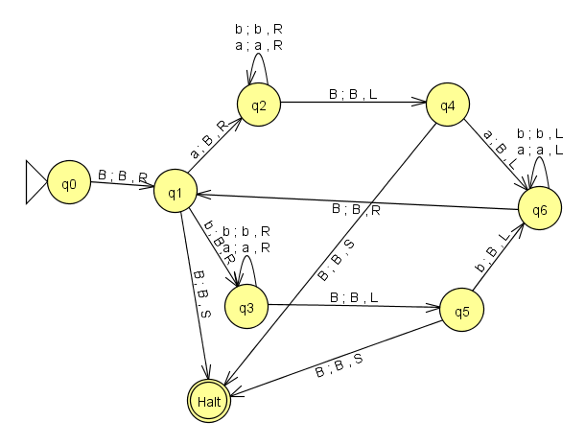
State Diagram

Slide 20
Transition Table
STATE | INPUT-a | INPUT-b | B
q0 |  |  | (q1,B,R)
q1 | (q2,B,R) | (q3,B,R) | (h,B,S)(even)
q2 | (q2,a,R) | (q2,b,R) | (q4,B,L)
q3 | (q3,a,R) | (q3,b,R) | (q5,B,L)
q4 | (q6,B,L) | - | (h,B,R) (odd)
q5 |  | (q6,B,L) | (h,B,R) (odd)
q6 | (q6,a,L) | (q6,b,L) | (q1,B,R )
Halt (Accept)

Slide 21
ID
Trace: baab
qoBbaabB
|- Bq1baabB
|- BBq3aabB
|-BBaq3abB
|-BBaaq3bB
|- BBaabq3B
|- BBaaq5bB
|- BBaq6aBB
|- Bq6aaBB
|-Bq6BaaBB
|-BBq1aaBB
|-BBBq2aBB
|-BBBq2aBB
|-BBBaq2BB
|-BBBq4aBB
|- BBq6BBBB
|-BBBq1BBB
Halt
Accept

Slide 22
Trace: aba
Trace aba,
(q0,BabaB)
|- ( q1,BabaB)
|-(q2,BBbaB)
|- (q2,BBbaB)
|- (q2,BBbaB)
|- (q4,BBbaB)
|- (q6,BBbBB)
|- (q6,BBbBB)
|- (q0,BBbBB)
|- (q3,BBBBB)
|- (q5,BBBBB)
|- halt

Slide 23
3. Design TM to accept L={x∈{a,b}* | x contains the substring aba}
Logic:
Halt when the first occurrence of ‘aba’
BbabaaB
BbabaaB
BbabaaB
BbabaaB
BbabaaB
BbabaaB
BbabaaB Accept

Slide 24
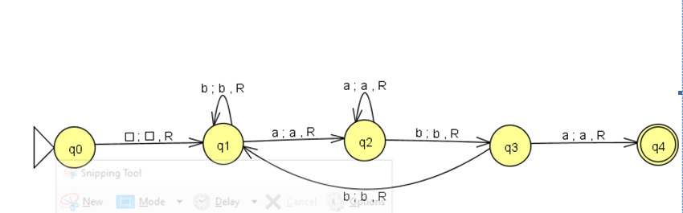
State Diagram

Slide 25
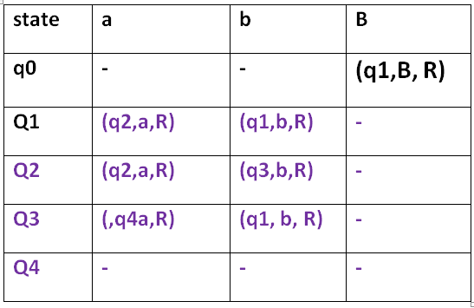
Transition Table

Slide 26
Trace the input
(q0, Baabbaba)
|- ( q1, B a a b b a b a)
|- (q2 ,B a a b b a b a)
|- (q2,B a a b b a b a)
|- (q3,B a a b b a b a)
|- (q1, B a a b b a b a)
|- (q2, B a a b b a b a)
|- (q3, B a a b b a b a)
|- (q4, B a a b b a b a)

Slide 27
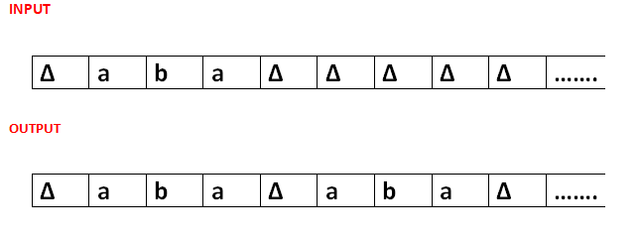
4. Construct a Turing machine to copy a string
1.∆aba∆∆∆∆ | 11.∆Aba∆a∆∆ | 21.∆ABA∆ab∆∆ | 31.∆ABa∆aba∆
2.∆aba∆∆∆∆ | 12.∆ABa∆a∆∆ | 22.∆ABA∆ab∆∆ | 32.∆Aba∆aba∆
3.∆Aba∆∆∆∆ | 13.∆ABa∆a∆∆ | 23.∆ABA∆ab∆∆ | 33.∆aba∆aba∆
4.∆Aba∆∆∆∆ | 14.∆ABa∆∆a∆∆ | 24.∆ABA∆ab∆∆
5.∆Aba∆∆∆∆ | 15.∆ABa∆a∆∆∆ | 25.∆ABA∆aba∆
6. ∆Aba∆∆∆∆ | 16.∆ABa∆ab∆∆ | 26.∆ABA∆aba∆
7.∆Aba∆a∆∆ | 17.∆ABa∆ab∆∆ | 27.∆ABA∆aba∆
8.∆Aba∆a∆∆ | 18.∆ABa∆ab∆∆ | 28.∆ABA∆aba∆
9.∆Aba∆a∆∆ | 19.∆ABa∆ab∆∆ | 29.∆ABA∆aba∆
10.∆Aba∆a∆∆ | 20.∆ABa∆ab∆∆ | 30.∆ABA∆aba∆

Slide 28
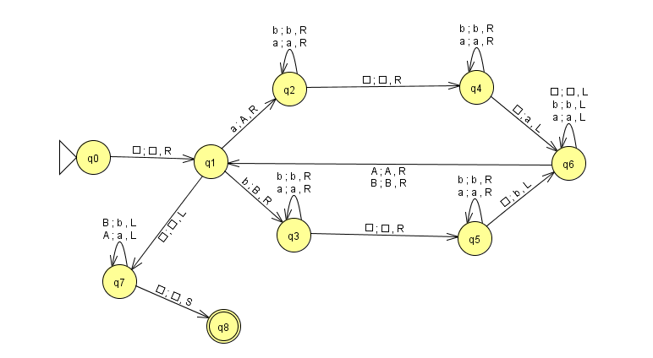
State Diagram

Slide 29
Transition Table
STATE | INPUT-a | INPUT-b | A | B | ∆
q0 |  |  |  |  | (q1, ∆,R)
q1 | (q2, A,R) | (q3, B,R) |  |  | (q7, ∆,L)
q2 | (q2, a,R) | (q2, b,R) |  |  | (q4, ∆,R)
q3 | (q3, a,R) | (q3, b,R) |  |  | (q5, ∆,R)
q4 | (q4, a,R) | (q4, b,R) |  |  | (q6, a,L)
q5 | (q5, a,R) | (q5, b,R) |  |  | (q6, b,L)
q6 | (q6, a,L) | (q6, b,L) | (q0,A,R) | (q0,B,R) | (q6, ∆ ,L)
q7 |  |  | (q7, a,L) | (q7, b,L) | (q8, ∆,S)
q8 halt

Slide 30
Trace to Copy: ab
(q0, ∆ab∆∆∆∆∆)
|-(q1, ∆ab∆∆∆∆∆)
|-(q2, ∆Ab∆∆∆∆∆)
|-(q2, ∆Ab∆∆∆∆∆)
|-(q4, ∆Ab∆∆∆∆∆)
|-(q6, ∆Ab∆a∆∆∆)
|-(q6, ∆Ab∆a∆∆∆)
|-(q6, ∆Ab∆a∆∆∆)
|-(q1, ∆Ab∆a∆∆∆)
|-(q3, ∆AB∆a∆∆∆)
|-(q3, ∆AB∆a∆∆∆)
|-(q5, ∆AB∆a∆∆∆)
|-(q5, ∆AB∆a∆∆∆)
|-(q6, ∆AB∆ab∆∆)
|-(q6, ∆AB∆ab∆∆)
|-(q6, ∆AB∆ab∆∆)
|-(q1, ∆AB∆ab∆∆)
|-(q7, ∆AB∆ab∆∆)
|-(q7, ∆Ab∆ab∆∆)
|-(q7, ∆ab∆ab∆∆)
q8 Accept

Slide 31
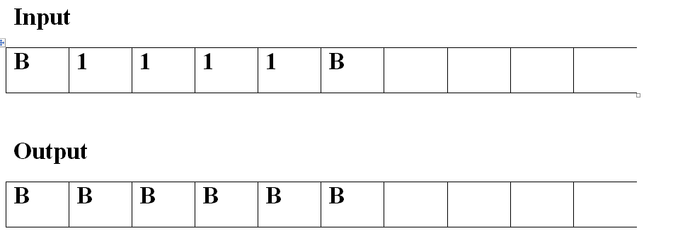
5. Construct TM to compute n mod 2
Even
1.∆1111∆∆∆∆ | 7. ∆1111∆∆∆∆
2. ∆1111∆∆∆∆ | 8. ∆111∆∆∆∆∆
3.∆1111∆∆∆∆ | 9. ∆11∆∆∆∆∆ ∆
4. ∆1111∆∆∆∆ | 10. ∆1∆∆∆∆∆ ∆∆
5. ∆1111∆∆∆∆ | 11. ∆∆∆∆∆∆ ∆∆∆
6. ∆1111∆∆∆∆ | Halt

Slide 32
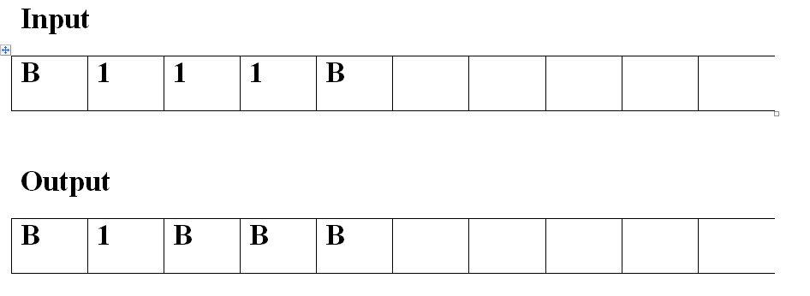
Construct TM to compute n mod 2
Odd
1.∆1111∆∆∆∆ | 8. ∆111∆∆∆∆∆
2. ∆1111∆∆∆∆ | 9. ∆11∆∆∆∆∆ ∆
3.∆1111∆∆∆∆ | 10. ∆1∆∆∆∆∆ ∆∆
4. ∆1111∆∆∆∆ | 11. ∆∆∆∆∆∆ ∆∆∆
5. ∆1111∆∆∆∆ | 12. ∆∆∆∆∆∆ ∆∆∆
6. ∆1111∆∆∆∆ | 13. ∆1∆∆∆∆ ∆∆∆
7. ∆1111∆∆∆∆ | 14. halt

Slide 33
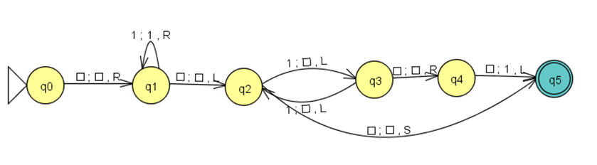
State Diagram

Slide 34
ID
Trace : 1111
(q0,B1111B)
|-(q1,B1111B)
|-(q1,B1111B)
|-(q1,B1111B)
|-(q1,B1111B)
|-(q1,B1111B)
|-(q2,B1111B)
|-(q3,B111BB)
|-(q2,B11BBB)
|-(q3,B1BBBB)
|-(q2,BBBBBB)
|-(q5) Accept

Slide 35
ID
Trace : 111
(q0,B111B)
|-(q1,B111B)
|-(q1,B111B)
|-(q1,B111B)
|-(q1,B111B)
|-(q2,B111B)
|-(q3,B11BB)
|-(q2,B1BBB)
|-(q3,BBBBB)
|-(q4,BBBBB)
|-(q5,B1BBB)
Accept

Slide 36
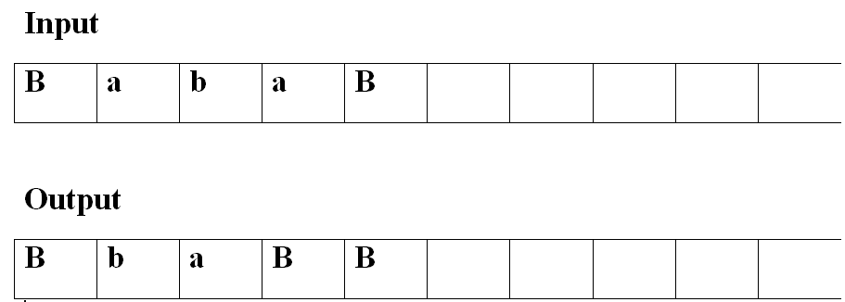
6. Construct a Turing machine to delete a symbol
1.∆aba∆∆∆∆
2.∆aba∆∆∆∆
3.∆∆ba∆∆∆∆
4. ∆∆ba∆∆∆∆
5.∆∆ba∆∆∆∆
6. ∆∆ba∆∆∆
7.∆∆b∆∆∆ ∆
8. ∆∆a∆ ∆∆∆
9.∆ba∆ ∆∆∆
10.halt

Slide 37
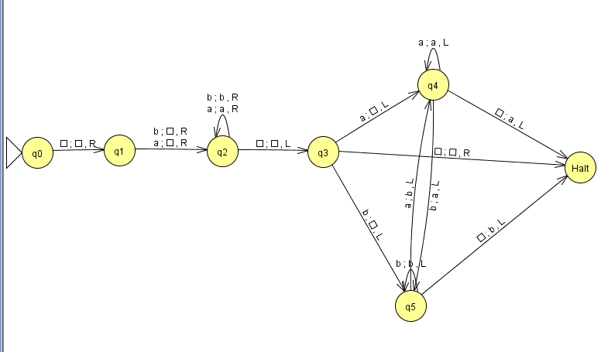
State Diagram

Slide 38
Trace to delete a symbol in : bba
(q0, ∆ bba ∆ )
|- ( q1, ∆ bba ∆)
|- ( q2, ∆ ∆ ba ∆)
|- ( q2, ∆ ∆ ba ∆)
|- ( q2, ∆ ∆ ba ∆)
|- ( q3, ∆ ∆ ba ∆)
|- ( q4, ∆ ∆ b ∆ ∆)
|- ( q5, ∆ ∆ a ∆ ∆)
|- ( Halt, ∆ b a ∆ ∆)

Slide 39
7. Obtain a TM L={SS | S∈ {a,b}*}
Execution logic :
Find the middle point
Compare two halves
Middle point Procedure |  | Compare procedure
Δ a b b a b b Δ |  | Δ a b b A B B Δ
Δ a b b a b b Δ | Δ A B B A B B Δ | Δ a b b A B B Δ
Δ A b b a b b Δ | Δ A B B A B B Δ | Δ A b b A B B Δ
Δ A b b a b b Δ | Δ a b b A B B Δ | Δ A b b Δ B B Δ
Δ A b b a b B Δ |  | Δ A b b Δ B B Δ
Δ A b b a b B Δ |  | Δ A B b Δ B B Δ
Δ A B b a b B Δ |  | Δ A B b Δ Δ B Δ
Δ A B b a b B Δ |  | Δ A B b Δ Δ B Δ
Δ A B b a B B Δ |  | Δ A B B Δ Δ B Δ
Δ A B b a B B Δ |  | Δ A B B Δ Δ B Δ
Δ A B B a B B Δ |  | Δ A B B Δ Δ Δ Δ
Δ A B B a B B Δ |  | Δ A B B Δ Δ Δ Δ

Slide 40
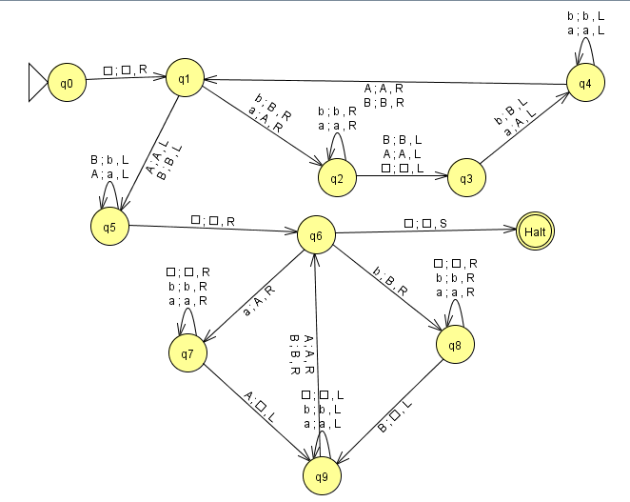
State Diagram

Slide 41
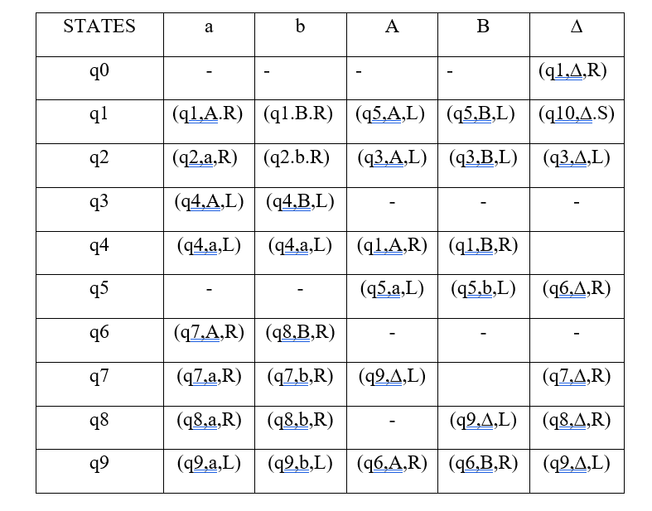
Transition Table: δ

Slide 42
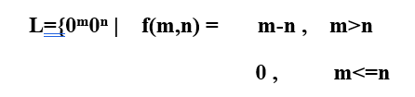
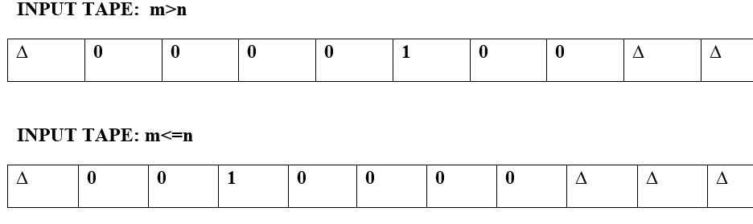

8. Construct a Turing Machine for subtraction :

Slide 43
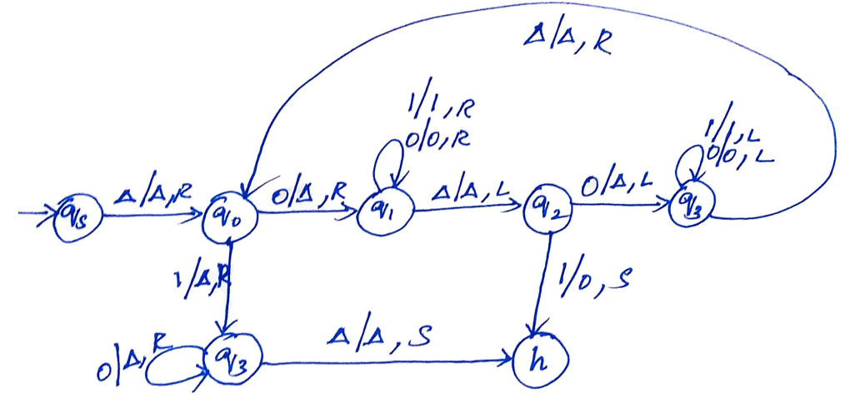
State Diagram

Slide 44
Universal Turing Machine
A Universal Computing Machine
It is a TM, whose input consists of 2 parts
A string specifying some other (special purpose) TM- T1
A string Z( input to the TM- T1)
The TM, Tu then simulates the processing of Z by T1

Slide 45
Construction of Tu
Step 1: Formulate a notational system
For each tape symbol ( including Blank)
For each state ( including halt state)
Three directions
For Input Symbols:
∆- 0
a-00
b-000
For each State:
Halt- 0
q0-00
P-000
R-0000

Slide 46
For Directions:
S-0
L-00
R-000
For beginning of string and ending of string – 11
For comma encoding is- 1
Tu- represents the universal TM
T1 – represents the name of special TM
Tu = e(T1) . e(Z)

Slide 47
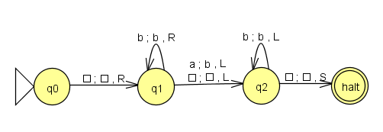
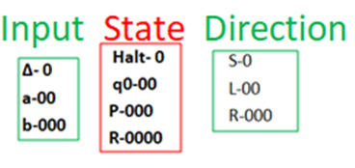
Construct a Tu for the TM
Transition Function:
δ(q0, ∆)=(q1, ∆, R)
00 1 0 1 000 1 0 1 000
δ(q1, b)=(q1, b, R)
000 1 000 1 000 1 000 1 000
δ(q1, ∆)=(q2, ∆, L)
000 1 0 1 0000 1 0 1 00
δ(q1, a)=(q2, b, L)
000 1 00 1 0000 1 000 1 00
δ(q2, b)=(q2, b, L)
0000 1 000 1 0000 1 000 1 00
δ(q2, ∆)=(Halt, ∆, S)
0000 1 0 1 0 1 0 1 0

Slide 48
e(T) = δ(q0, ∆)=(q1, ∆, R) 11 δ(q1, b)=(q1, b, R) 11δ(q1, ∆)=(q2, ∆, L) 11 δ(q1, a)=(q2, b, L) 11 δ(q2, b)=(q2, b, L) 11δ(q2, ∆)=(Halt, ∆, S)
e(T) = 00 1 0 1 000 1 0 1 000 11 000 1 000 1 000 1 000 1 000 11 000 1 0 1 0000 1 0 1 00 11 000 1 00 1 0000 1 000 1 00 11 0000 1 000 1 0000 1 000 1 00 11 0000 1 0 1 0 1 0 1 0
Assume Z=baa
e(Z) = 000 1 00 1 00
Tu = e(T1) . e(Z)

Slide 49
Tu = e(T1) . e(Z)
Tu= 11 00 1 0 1 000 1 0 1 000 11 000 1 000 1 000 1 000 1 000 11 000 1 0 1 0000 1 0 1 00 11 000 1 00 1 0000 1 000 1 00 11 0000 1 000 1 0000 1 000 1 00 11 0000 1 0 1 0 1 0 1 0 11 000 1 00 1 00 11

Slide 50
Turing Machine Types
Multi-Head Turing Machine
2-way infinite tape TM
Multi-tape Turing machine
Offline Turing Machine

Slide 51
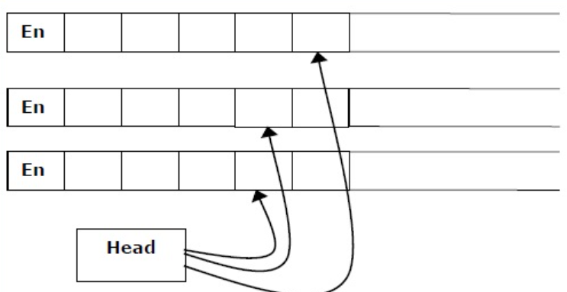
Multi-Head Turing Machine

Slide 52
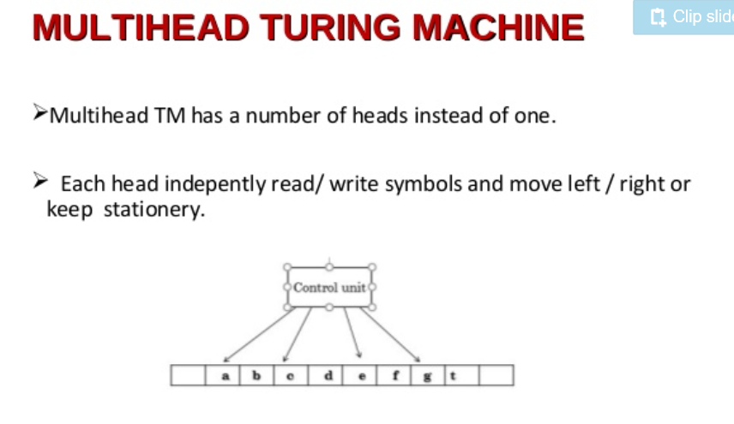

Slide 53
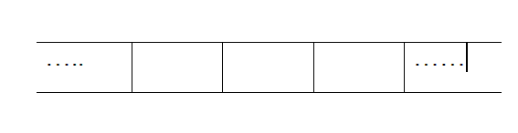
2-way infinite tape TM
Both ends are infinite

Slide 54
Multi-tape Turing machine
Extra Tapes
Single tape head scan the same position on all tapes.

Slide 55
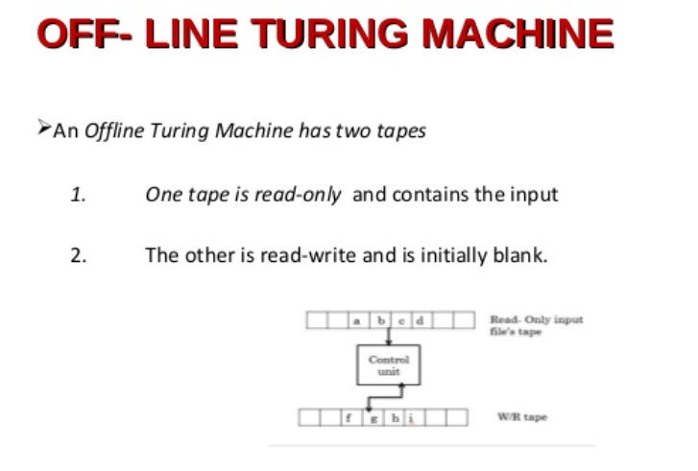

Slide 56
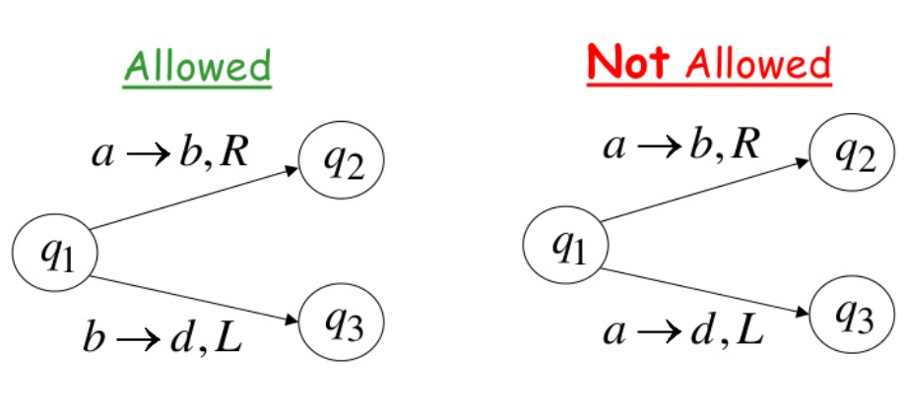
Deterministic TM
No Null Transition is allowed

Slide 57
Non-Deterministic Turing Machine
For every state and symbol, there are a group of actions the TM have.
The computation of a non-deterministic Turing Machine is a tree
If all branches of the computational tree halt on all inputs, the non-deterministic Turing Machine is called a Decider
If for some input, all branches are rejected, the input is also rejected.

